Slide 1
Software Debugging

Slide 2
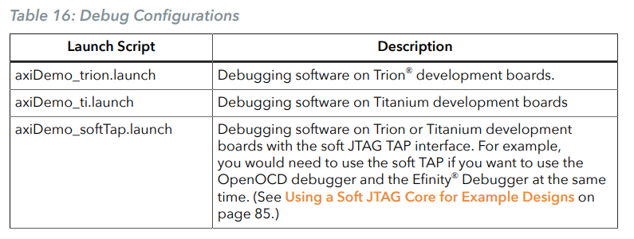

Debug with the OpenOCD Debugger
With the development board programmed and the software built, you are ready to configure the OpenOCD debugger and perform debugging. These instructions use the axi4Demo example to explain the steps required.
Launch the Debug Script :
With the Efinity software v2022.2 and higher, debugging scripts are available for each software example in the /embedded_sw/<module>/software/ directory and are imported into your project when you create a new project or importing existing project into the workspace. You can use these scripts to launch the debug mode.

Slide 3
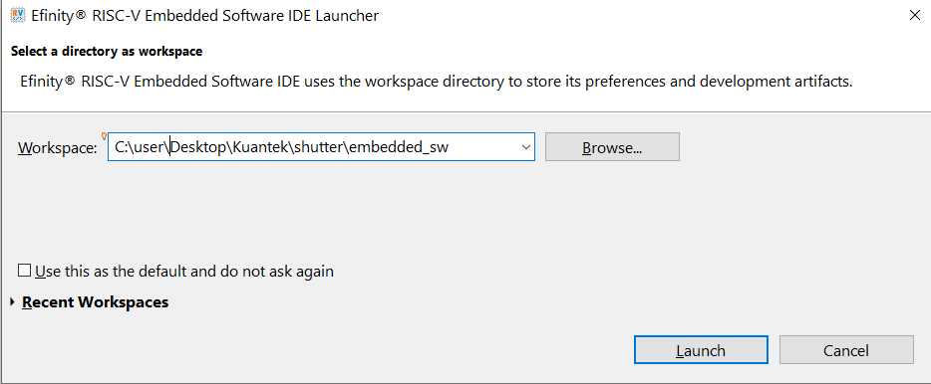
You need to select a workspace directory to store the IDE's preferences, configurations and temporary information. Follow these steps:
Click Browse and select your preffered location.
You may click the Recent Workspaces to select a previous workspace.
Click Launch.

Slide 4
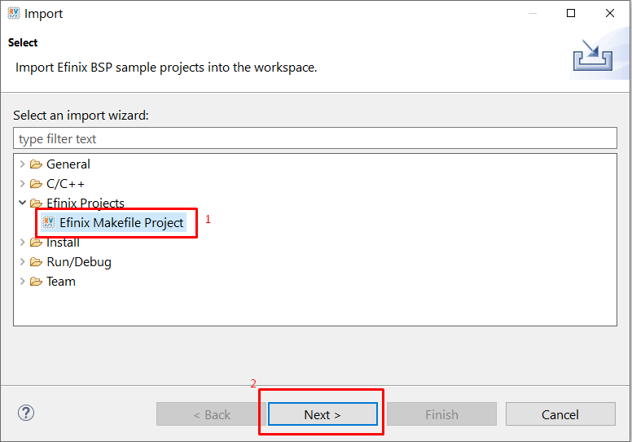
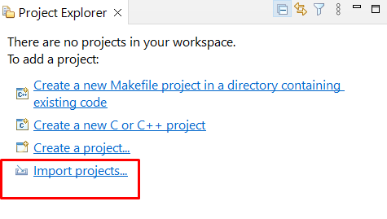
Import a Project
In the Project Explorer:
Click Import Projects to import the new project wizard.
Select the Efinix Project > Efinix Makefile Project > Next . In the New Efinix Makefile Project Wizard window:

Slide 5
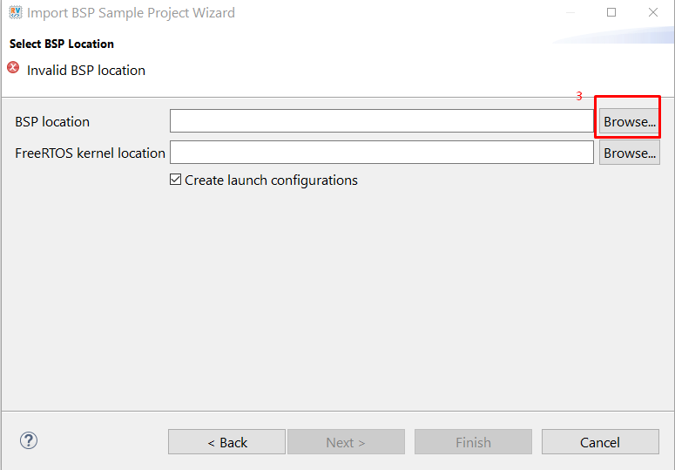
In the Import BSP Sample Project Wizard, click Next to browse to the next BSP location box.
If you would like to import the FreeRTOS sample projects, browse to the FreeRTOS kernel location. Turn on Create launch configurations and click Next.

Slide 6
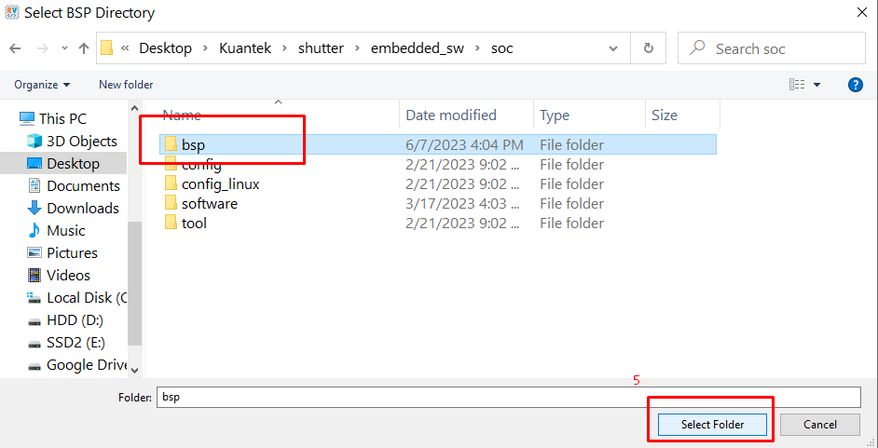
Click on Browse > Board Support Package (BSP). BSP location is generated by Efinity when you generate the Sapphire SoC with the IP Manager. Example BSP location: C:/<Project name>/embedded_sw/<ip name>/bsp/.

Slide 7
The next wizard page shows the Import BSP Sample Project Wizard, all sample projects are located in the embedded_sw/<soc name>/software are shown. Follow these steps:
Turn on the specific project to import that project.
You may turn on the sub-category, for example: Free RTOS, to import all the projects belonging to that particular sub-category.
Alternatively, you may click Select all / Deselect all to select or deselect all the projects available.
Click Next.

Slide 8
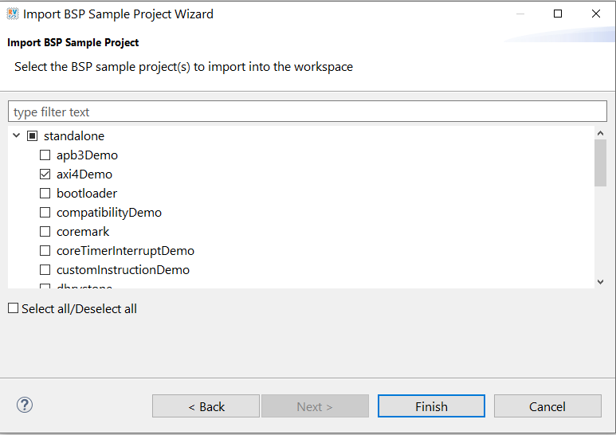

Slide 9
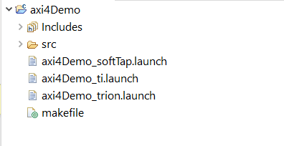
The new projects are updated in the Project Explorer pane. All required files are imported automatically. Launch scripts for softTap, ti, and trion configurations are generated automatically.

Slide 10
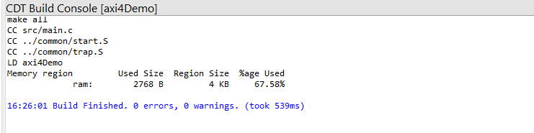
You can now browse the source files. To build the project, right-click the project name and select Clean Project > Build Project. The compilation output shows up in the Console window.

Slide 11
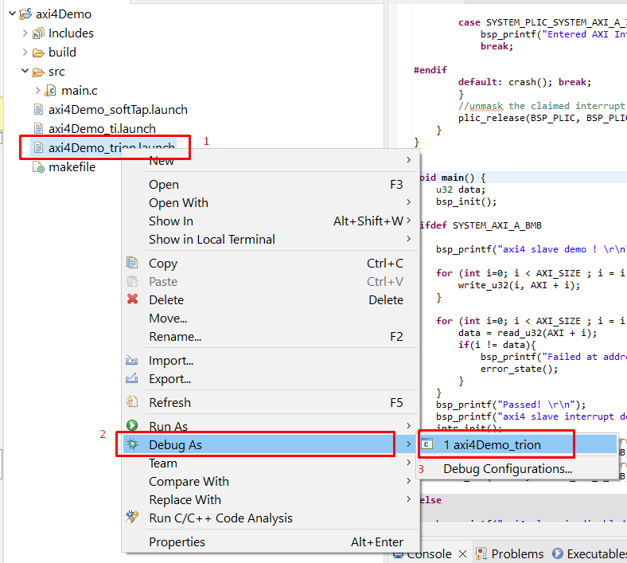
To debug the axi4Demo project:
Right-click axi4Demo > axi4Demo_<family>.launch.
Choose Debug As > axi4Demo > axi4Demo_<family>. Efinity RISC-V Embedded Software IDE launches the OpenOCD debugger for the project.

Slide 12
Click Debug.
Confirm Perspective Switch window would prompt out. Click Switch to switch from C/C++ perspective to Debug perspective to start the debug process.

Slide 13
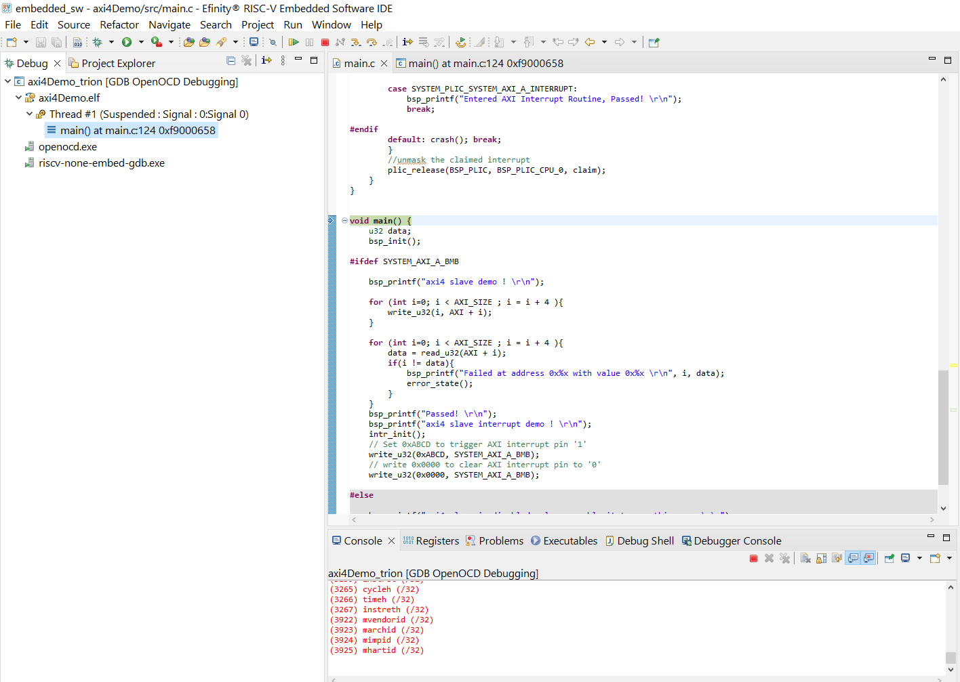
Debug
After you click Debug in the Debug Configuration window, the OpenOCD server starts, connects to the target, starts the gdb client, downloads the application, and starts the debugging session.
Messages and a list of VexRiscv registers display in the Console. The main.c file opens so you can debug each step.

Slide 14
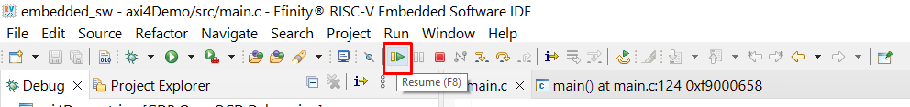
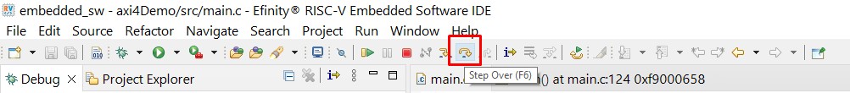
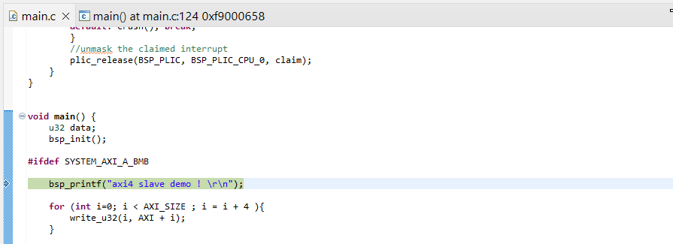
Click the Resume button or press F8 to resume code operation.
Click Step Over (F6) to do a single step over one source instruction.

Slide 15
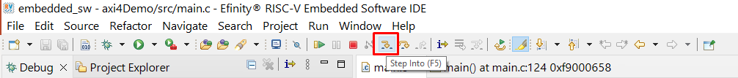
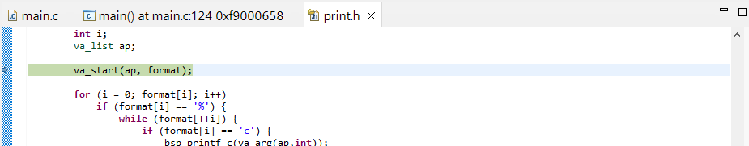
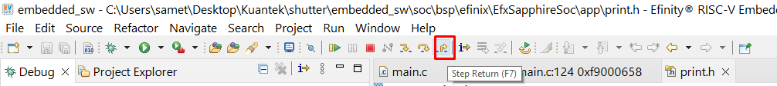
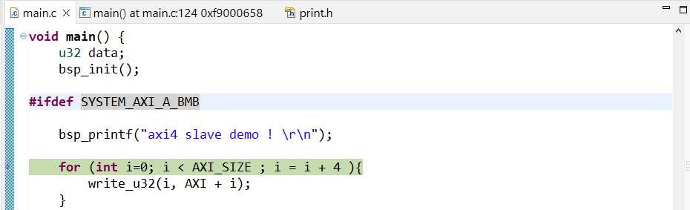
Click Step Into (F5) to do a single step into the next function called.
Click Step Return (F7) to do a single step out of the current function.

Slide 16
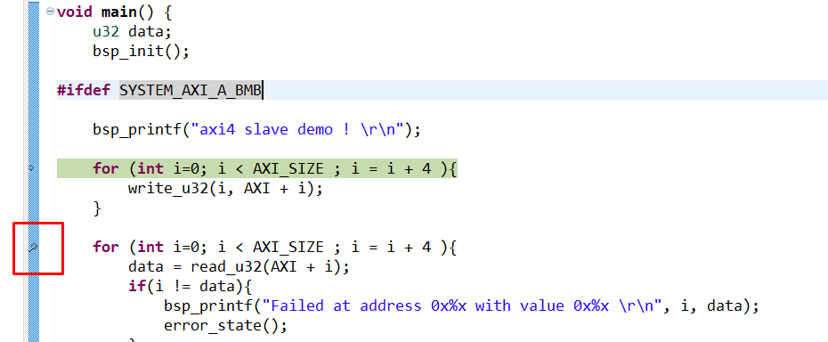
Double-click in the bar to the left of the source code to set a breakpoint. Double click a breakpoint to remove it.

Slide 17
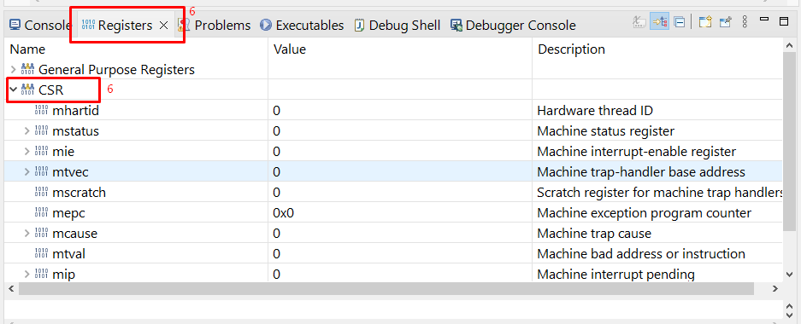
Click the Registers tab to inspect the processor's registers including the CSR registers.

Slide 18
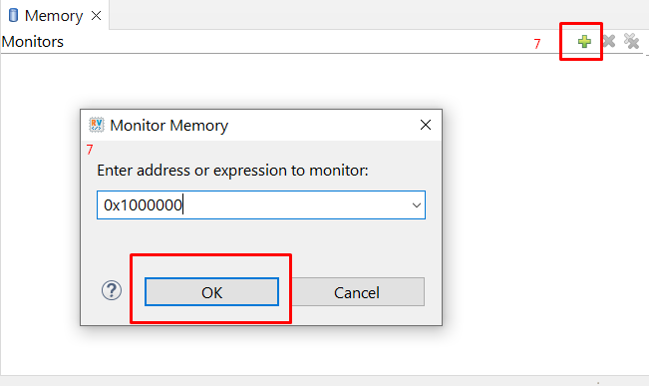
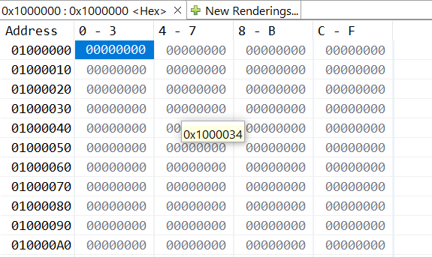
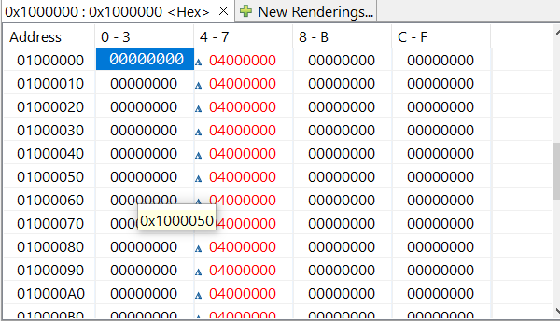
Click the Memory tab to inspect the memory contents including the Peripheral register monitors. You can show memory from enter a address.
If you write data to the address, the location of that address will be colored red and will change.

Slide 19
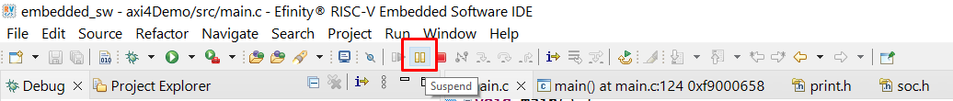
Click the Suspend button to stop the code operation.
Turn on any peripheral in the Peripheral pane to add the peripheral to the Memory monitor.
When you finish debugging, click Terminate to disconnect the OpenOCD debugger.

Slide 20
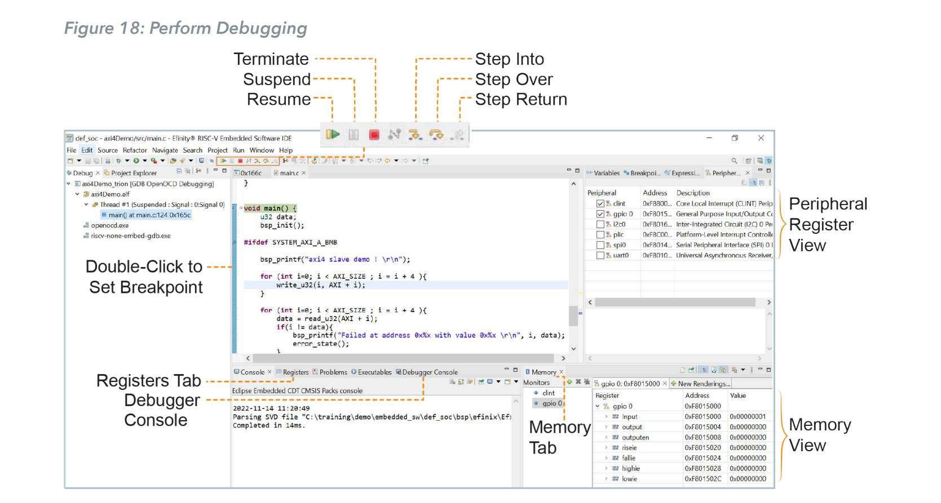

Slide 21
Debug – Multiple Cores
By default, the OpenOCD debugger always targets the first core, core 0, when debugging. If your SoC has multiple cores, you can do standalone debugging with a core other than core 0.
This debug method uses the openocdServer debug launch scripts, which are available in the software/standalone/openocdServer directory. The general procedure is:
Create an SoC with more than 1 core.
Import your software project in Efinity RISC-V Embedded Software IDE.

Slide 22
Import openocdServer project with New > Makefile Project with Existing Code.
Start the OpenOCD server.
Right-click openocdServer > openocdServer_<family>.launch.
Choose Debug As > openocdServer_<family>.
Modify the debug configuration for your application to use the OpenOCD server:
Right-click <Projectfolder> > Debug As > Debug Configurations.
Choose GDB OpenOCD Debugging > <launch script> (e.g., axiDemo_trion).
Click the Debugger tab.
Turn off Start OpenOCD locally.

Slide 23
Under Remote Target, change the Port number for the core you are using (the default is 3333 for core 0).
3333: Core 0
3334: Core 1
3335: Core 2
3336: Core 3
Click Debug. The RISC-V IDE enters into debug mode targeting the CPU that you specified with the port number.

Slide 24
